Slide 1
Verbal Odds n’ Ends*

Slide 2
Transitive
Mark 1:8
“I baptized (ἐβάπτισα) you with water, but he will baptize you with the Holy Spirit.”

Slide 3
Transitive
Phil 3:12
“Not that I have already obtained (ἔλαβον) all this, or have already arrived at my goal, but I press on to take hold of that for which Christ Jesus took hold of me” (NIV).
“Not that I have already obtained it or have already become perfect” (NASB).

Slide 4
Intransitive
Mark 1:7
“The one who is more powerful than I is coming (ἔρχεται) after me.”

Slide 5
Active: Stative
1 Tim 4:10
“We have placed our hope in the living God, who is (ἐστιν) the Savior of all people, particularly of those who believe.”
εἰμί is expressed or not

Slide 6
Time frame of speaker
Matt 3:2
“Repent, for the kingdom of heaven is at hand (ἤγγικεν).”

Slide 7
Time frame of speaker
John 5:45
“The one who accuses you is Moses, on whom you have set your hope (ἠλπίκατε).”

Slide 8
Active: Simple
Mark 1:12
“At once the Spirit drove (ἐκβάλλει) him out into the wilderness.”

Slide 9
Active: Causative
Matt 5:45
“He causes his sun to rise (ἀνατέλλει) on the evil and the good, and sends rain (βρέχει) on the righteous and the unrighteous” (NIV).

Slide 10
Passive: Simple
Mark 9:31
“The Son of Man is going to be delivered (παραδίδοται) into the hands of men.”
Agent expressed by ὑπό or unexpressed

Slide 11
Divine Passive
1 Cor 7:23
“You were bought (ἠγοράσθητε) at a price; do not become slaves of human beings” (NIV).

Slide 12
English Styles
Matt 27:63
“Sir, we remember that while he was still alive that impostor said, ‘After three days I will be raised (ἐγείρομαι).’”
“After three days I will rise again” (CSB).

Slide 13
Neuter Plural
Mark 4:4
“As he was sowing, some seed fell along the path, and birds (πετεινά) came (ἦλθεν) and ate it up.”

Slide 14
Articular Infinitive
2 Thess 2:6
“And now you know what is holding him in check (τὸ κατέχον), so that he may be revealed at his proper time.”

Slide 15
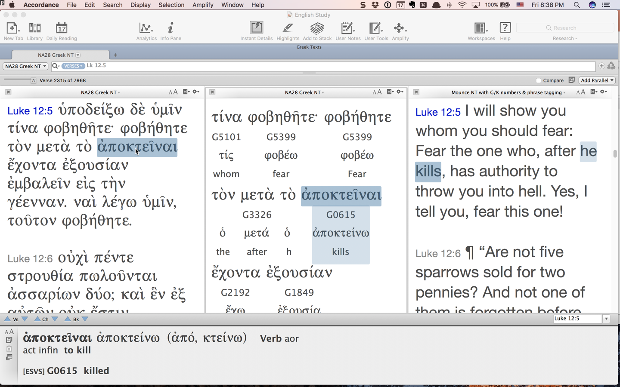
Articular Infinitive: Time (μετά)

Slide 16
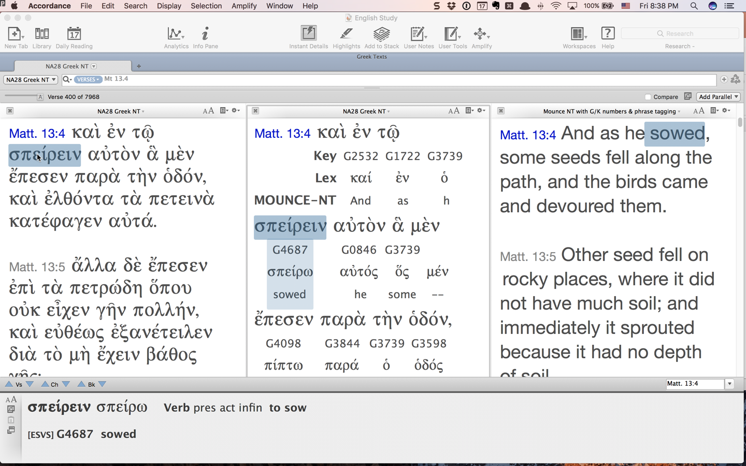
Articular Infinitive: Time (ἐν)

Slide 17
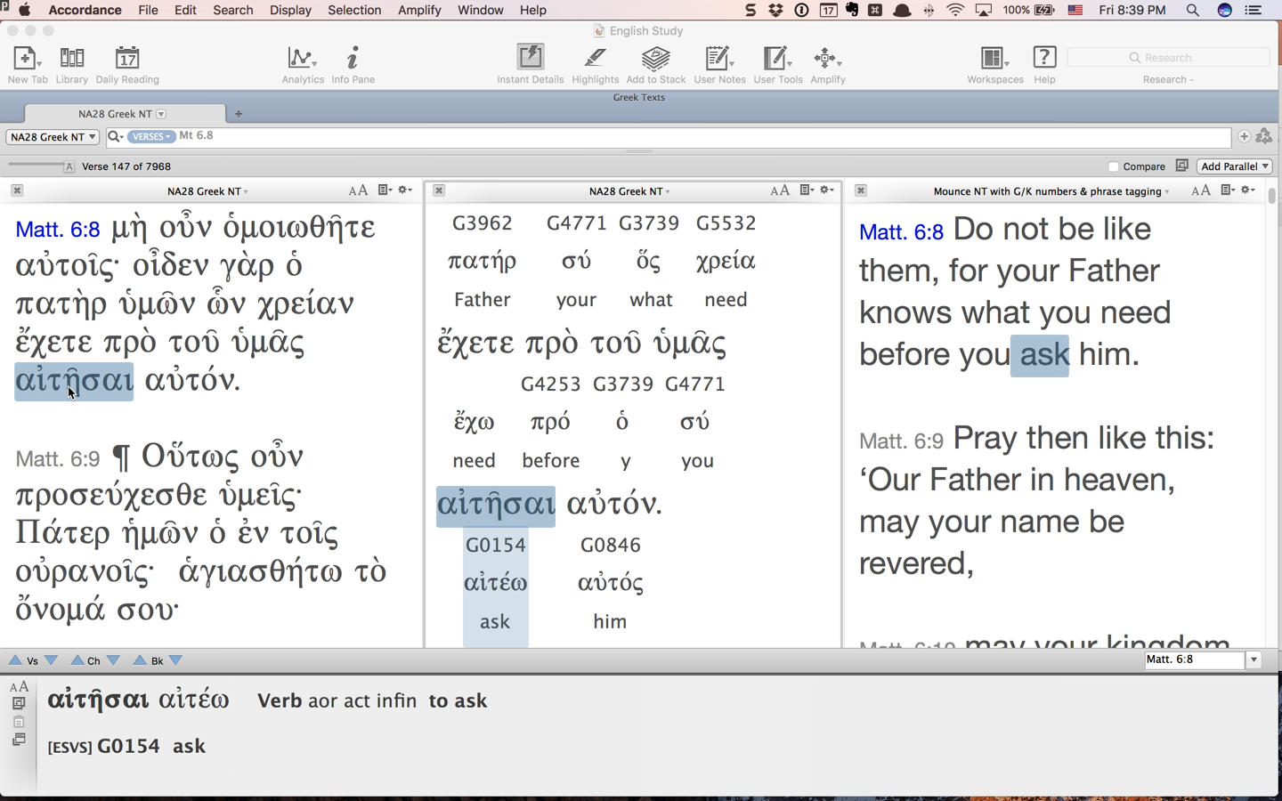
Articular Infinitive: Time (πρό)

Slide 18
Articular Infinitive: Cause/Reason (διά)
Matt 13:5
“Immediately it sprouted because it had (διὰ τὸ … ἔχειν) no depth of soil.”

Slide 19
Articular Infinitive: Purpose (εἰς)
Rom 6:12
“Do not let sin reign in your mortal body so that you obey (εἰς τὸ ὑπακούειν) its desires.”

Slide 20
Articular Infinitive: Purpose (πρός)
Matt 5:28
“Everyone who looks at a woman with lustful intent (πρὸς τὸ ἐπιθυμῆσαι) has already committed adultery with her in his heart.”

Slide 21
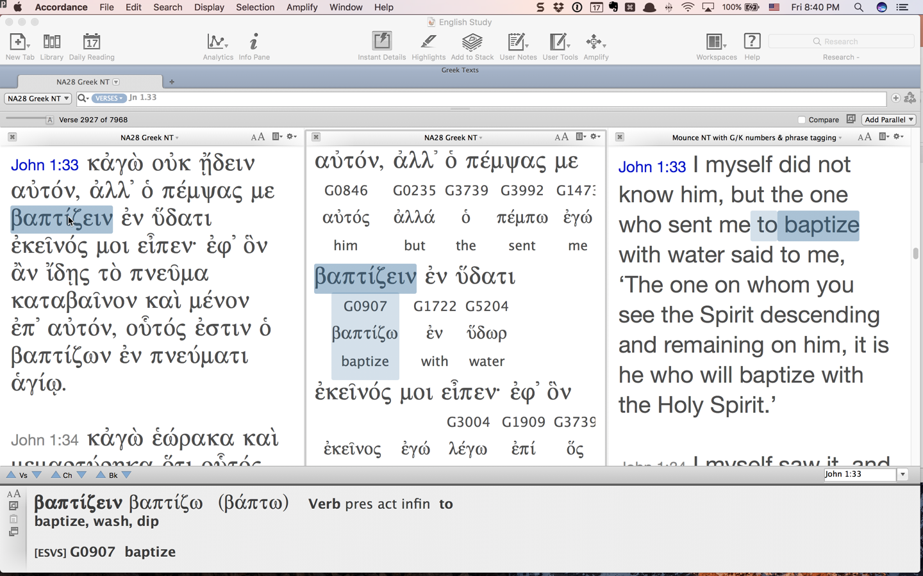
Infinitive: Purpose

Slide 22
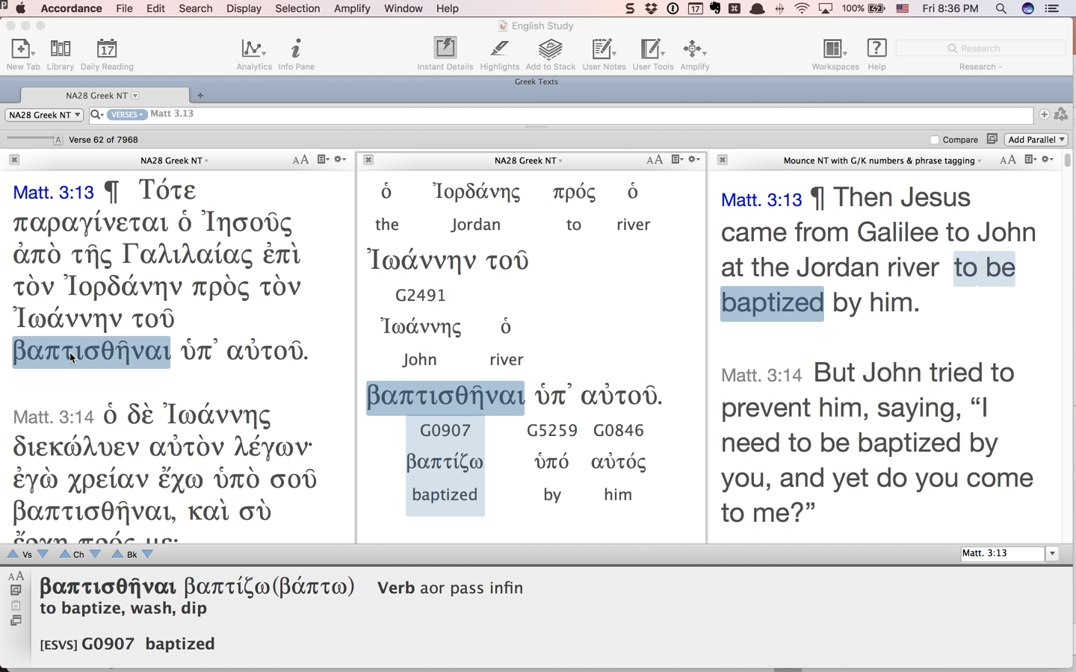
Infinitive: Purpose

Slide 23
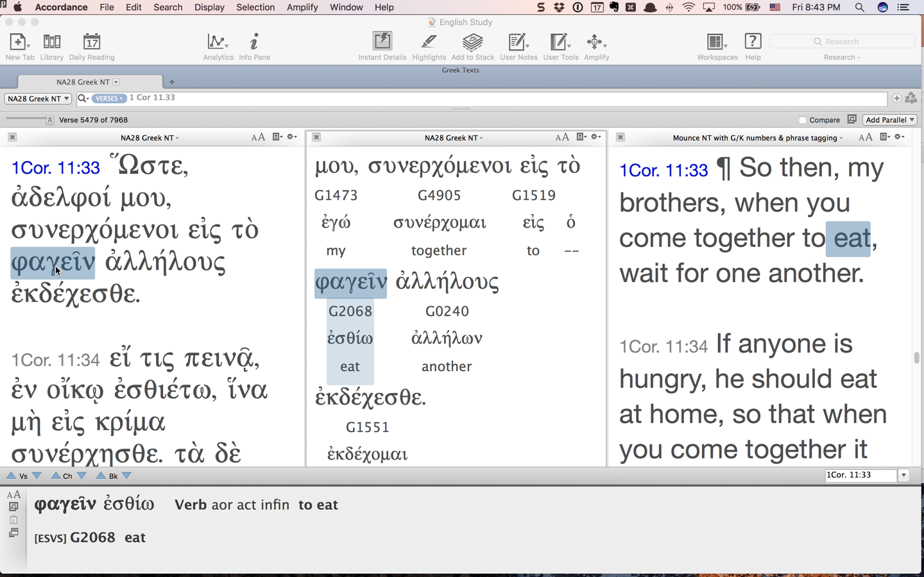
Purpose: εἰς + Infinitive

Slide 24
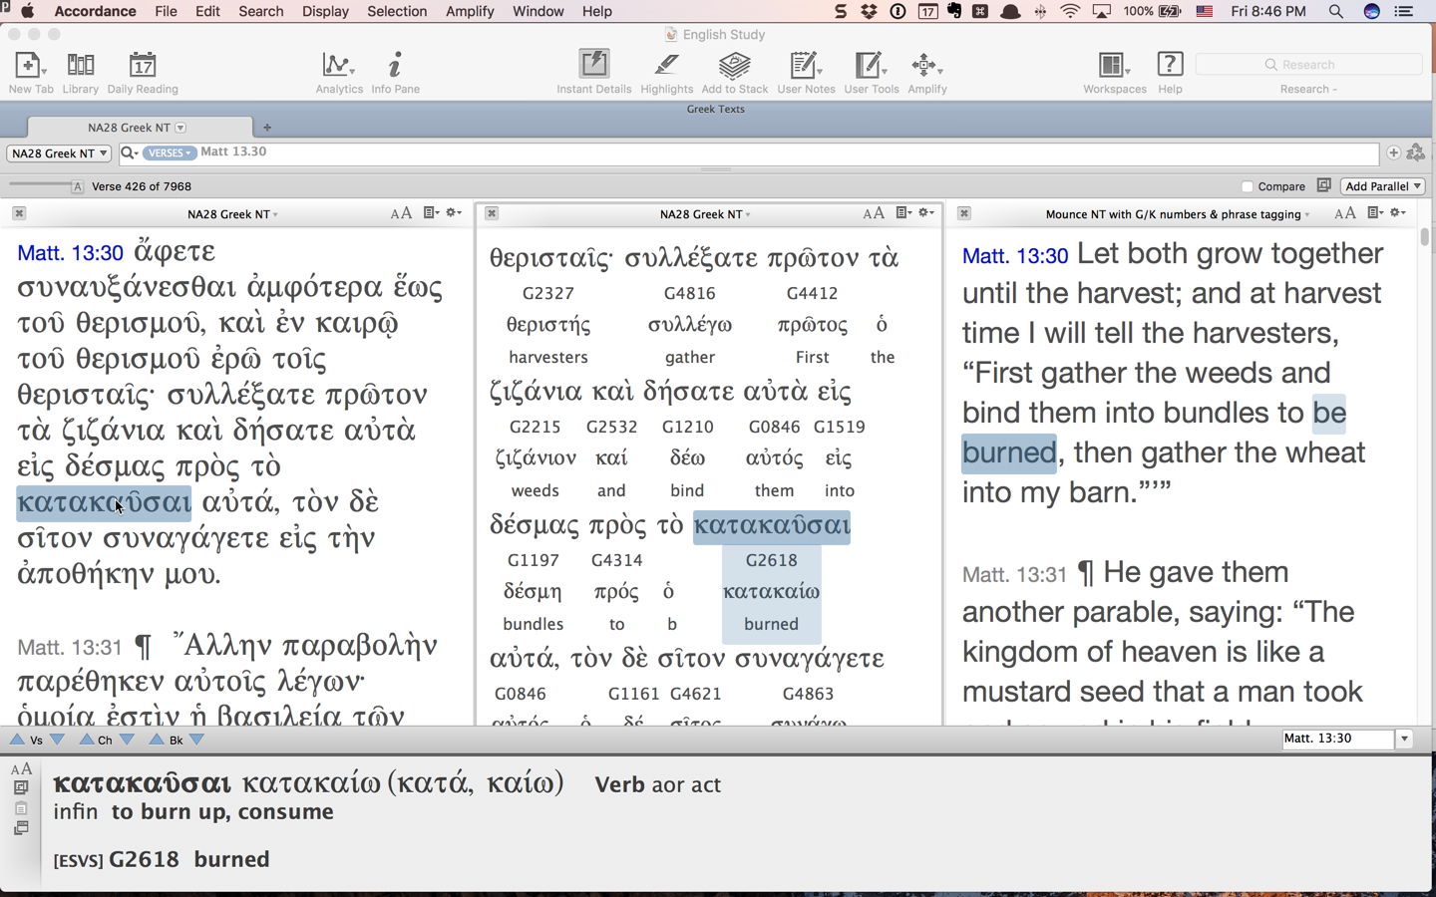
Purpose: πρός + Infinitive

Slide 25
Periphrastic
Mark 1:22
“For he taught (ἦν … διδάσκων) them as one who had authority, and not as the scribes.”

Slide 26
Genitive Absolute
Matt 12:46
“While he was still speaking (αὐτοῦ λαλοῦντος) to the people, behold, his mother and his brothers stood outside, asking to speak to him.”

Slide 27
Questions
Matt 8:26
“And he said to them, ‘Why (τί) are you (ἐστε) so afraid, you of little faith?’ Then he rose and rebuked the winds and the sea, and there was a great calm.”

Slide 28
Questions: Expect “Yes”
Rom 11:2
“Don’t you know (οὐκ οἴδατε) what Scripture says in the passage about Elijah—how he appealed to God against Israel?”

Slide 29
Questions: Expect “No”
Mark 2:19
“Can (μὴ δύνανται) the wedding guests fast while the bridegroom is with them?” (ESV)
“The wedding guests cannot fast while the groom is with them, can they?” (CSB)

Slide 30
Questions: Deliberative Subjunctive
Mark 12:14
“Is it lawful to pay tax to Caesar, or not? Should we pay (δῶμεν) or should we not pay (μὴ δῶμεν)?”

Slide 31
Optative
μὴ γένοιτο

Slide 32
Morphology
ἠγαπήσεν

Slide 33
Morphology
stem
ἠγαπήσεν

Slide 34
Morphology
stem
ἀγαπα

Slide 35
Morphology
stem
ἠγαπήσεν
augment

Slide 36
Morphology
stem
ἠγαπήσεν
augment
connecting vowel

Slide 37
Morphology
stem
ἠγαπήσεν
augment
connecting vowel
tense formative

Slide 38
Morphology
stem
ἠγαπήσεν
augment
personal ending
connecting vowel
tense formative

Slide 39
βάλλω
ἔβαλον
ἐβλήθην

Slide 40
βάλλω
ἔβαλον
ἐβλήθην

Slide 41
βάλλω
ἔβαλον
ἐβλήθην

Slide 42
βάλλω
ἔβαλον
ἐβλήθην

Slide 43
Present Active Indicative
1 sg λύω I loose
2 sg λύεις You loose
3 sg λύει He/she/it looses
1 pl λύομεν We loose
2 pl λύετε You loose
3 pl λύουσι(ν) They loose

